Slide 1
Healthcare Appointment No-show Analysis
Using Python EDA and Power BI Dashboard
Laksh Ranjan

Slide 2
Project Objective
Analyze patient appointment data to identify patterns behind no-shows.
Use Python for data cleaning and exploratory data analysis (EDA).
Build interactive visualizations in Power BI to present findings.

Slide 3
Dataset Overview
Total records: 110,527
Columns include demographics, medical conditions, appointment info.
Target variable: No-show (Yes/No).

Slide 4
Python EDA Tasks
Data Cleaning: Handled datetime parsing, removed invalid ages.
Feature Engineering: Created waiting days, converted date formats.
Univariate Analysis: Distribution of age, gender, conditions.
Bivariate Analysis: Impact of SMS, scholarship, age on no-shows.

Slide 5
Insights from EDA
No-show rate is ~20%.
Patients who received SMS were slightly more likely to show up.
Younger patients tend to miss appointments more frequently.
Certain neighborhoods show higher no-show rates.

Slide 6
Power BI Dashboard
Interactive filters for Age, Gender, Neighborhood.
KPI cards: Show-up rate, no-show rate.
Bar charts and heatmaps to visualize appointment trends.
Insights for better resource planning.

Slide 7
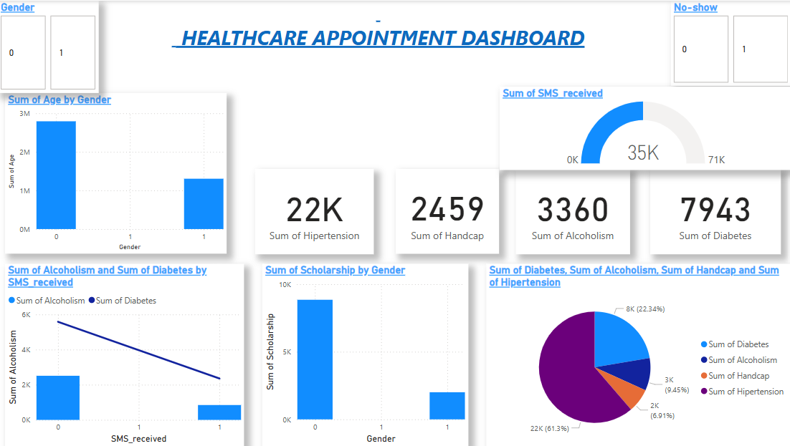
DASHBOARD

Slide 8
Conclusion & Recommendations
Improve communication for high-risk groups (young, certain areas).
Use predictive modeling to anticipate no-shows.
Consider incentives or follow-ups for patients with past no-shows.

